Slide 1
By Vicki Koc, Historian

Slide 2
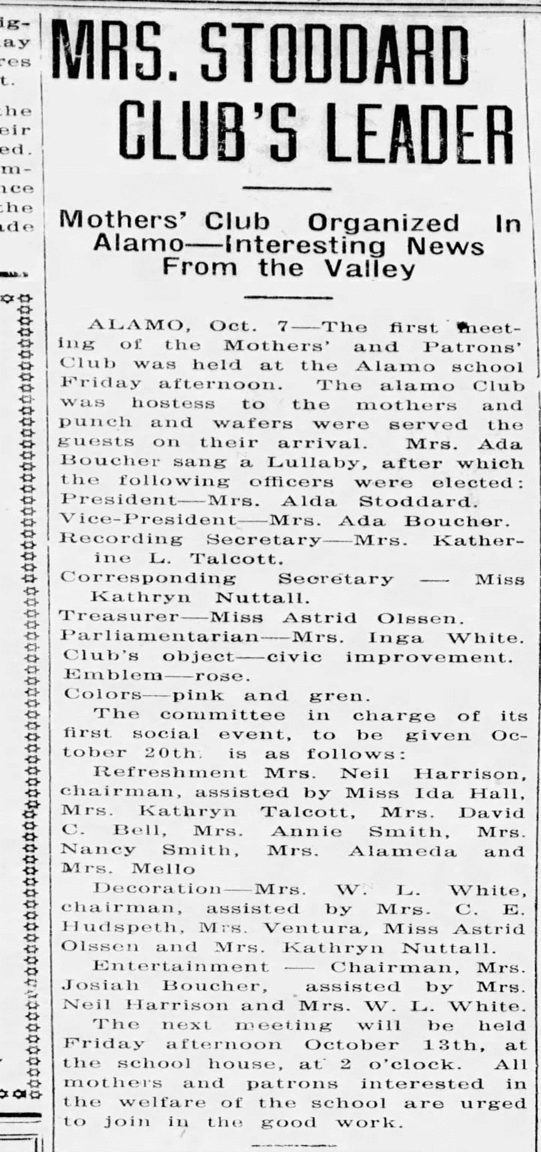
1916 Club Formation: The Alamo Mothers’ and Patrons’ Club formed for civic improvement and ‘welfare of the school.’
Original article from Martinez Gazette.
1922 They rename to the Alamo Community
Club.
They join Federation due to involvement
in suffragette support, according to verbal history.

Slide 3
THE WAY WE WERE

Slide 4
1920’s: Meetings were at the school, then rented space.
One vendor of this era took his payment in pies!
Early projects were a piano, gramophone and playground equipment.
Meetings became twice a month by 1920 – a business meeting and a ‘social tea’.
First discussions in 1922 held to look for a permanent Club home.
Dues in 1924 were $1.35.
This Photo by Unknown Author is licensed under CC BY-SA

Slide 5
1920 to 1930 Tidbits
The Club Tea Fund provided and made daily hot chocolate for the school. Milk bought by the case and chocolate in 3 lb. cans.
In 1930 they began to pay for a telephone.
This Photo by Unknown Author is licensed under CC BY-NC

Slide 6
Bites of History:
The flag salute and pledge were added to meetings in 1932.
For 68 years they staffed the Alamo library for Contra Costa County.

Slide 7
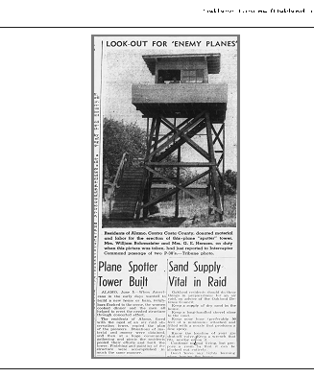
1930 to WW II: The Art of Homemaking was a president’s theme in 1932 and minutes refer to helping “The Old Ladies,” curing dental infections in rural children, and Saving the Redwoods
World Politics overrode their lives after the Great Depression up until 1950.
This photo is of the Air Raid Tower built on Alamo School grounds and manned throughout the war by women’s club families.

Slide 8
1940 minutes recall Red Cross Sewing Quotas. Photo shows club members making aprons.
In 1952 with the land donation and Clubhouse built, the moniker became the Alamo Women’s Club.
Membership swelled. Social activities prevailed.

Slide 9
1940 - 2000:Meetings, Fashion Shows and Rummage Sales

Slide 10
They wore these pantsuits in 1969:

Slide 11
The 1970’s era brought social disruption, saw women strongly enter the workplace, and nationwide club memberships decline.
This photo from 1994 has club members costumed in their take on the turbulent 1960 and 1970 eras.

Slide 12
2000 onwards: Members joining want to help their community and want to do more. Their presence broadens our philanthropy focus to more hands-on projects.
Today it is routine. We do more than write a check.
Volunteers Extraordinaire.

Slide 13
OUR SCHOLARSHIPS ADAPT TOO In 1939 one scholarship is given. After WW II scholarships re-emerge for nursing. Club focuses on high school and the arts from the mid 1980s. By 2010 focus expands to foster youth and single parents at DVC. In 2018 scholarship dollars increase and become need based.

Slide 14
In 2023, eleven $5,000 scholarships are awarded. One student wrote: “I have fought and battled every day since childhood to push through chronic illnesses, mental ailments and C-PTSD to achieve my goals to the best of my ability. I don’t plan on stopping; especially while my son’s watching and cheering me on. He’s my motivation to pursue and succeed in creating a brighter financially stable future for us, while positively impacting others.” Our hats are off to each recipient!
This Photo by Unknown Author is licensed under CC BY-SA

Slide 15
2010 brings change Publicity increases in newspaper and banners on the boulevard A website, logo and motto are adopted A Clubhouse facelift changing its tired 1950's look was completed in 2014. The Long Family donates for kitchen remodel in 2015. And we pay the loan off in record time!

Slide 16
Photos Then and Now
1952
2023

Slide 17
Then and Now:
1978
2023

Slide 18
More 2015 Changes:
Members vote to turn luncheons over to paid servers
Circa 2014 Wine is discontinued at lunches, which the Club paid for, but only after much heated discussion!!
Club discontinues paying for the President’s lunch and eliminates her designated parking space
Authors’ Faire begins

Slide 19
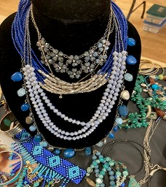
Jewelry sales begin in 2014, adapt and grow providing a constant scholarship funding source. In fact, funds raised from jewelry sales become the most raised via any fundraising project in AWC's entire history!

Slide 20
For 107 years AWC members demonstrate: Adapting to changing times Service to their community Enjoyment of each other’s friendship Doing good works living up to our motto
A place where women come together to work toward a better community for all.

